Slide 1
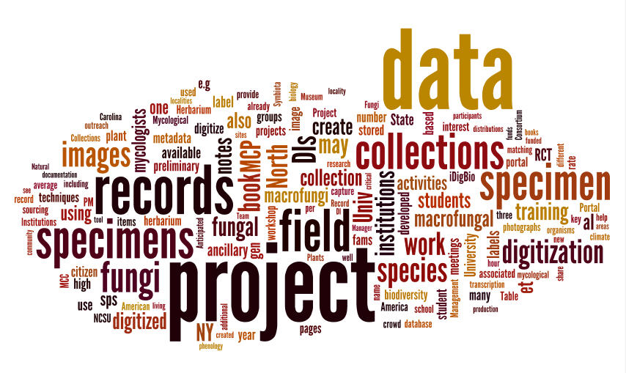
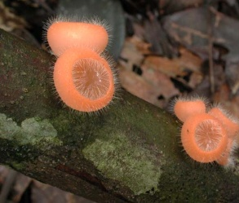
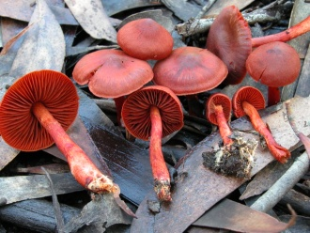
The Macrofungi Collections Consortium
Wordle based on proposal
Unlocking a Biodiversity Resource for Understanding Biotic Interactions, Nutrient Cycling and Human Affairs
Notes:
For this project we have fomed an alliance of essentially all of the herbaria that document the history of research on macrofungi over the past 150 years to digitize these specimens and make the data available for scientific research and human benefit.

Slide 2
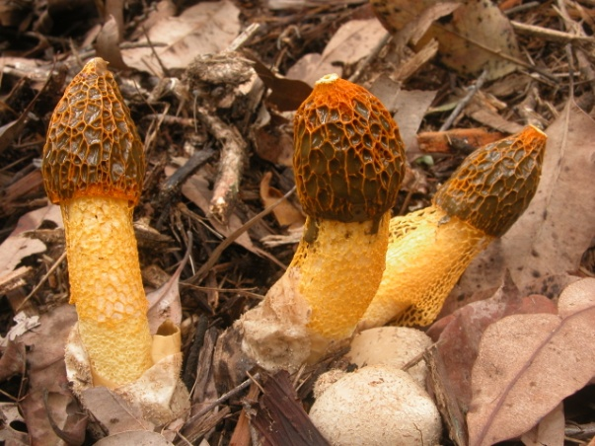
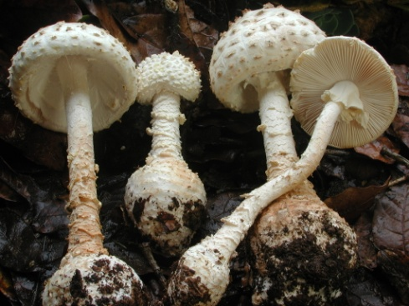
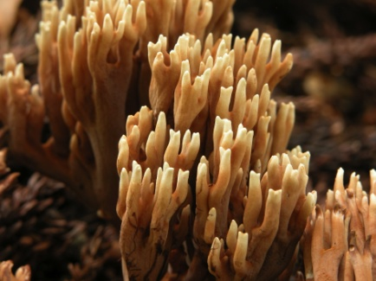
Goal of the Macrofungi Collections Consortium
To build an enduring alliance of the U.S. herbaria whose collections document the past 150 years of research on macrofungi that will digitize and share specimen data in support of a wide range of scientific and educational objectives

Slide 3
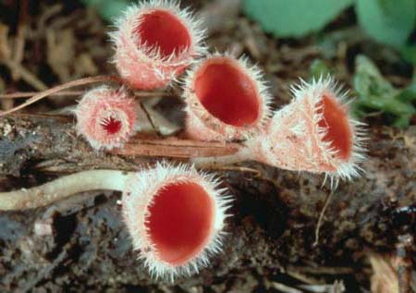
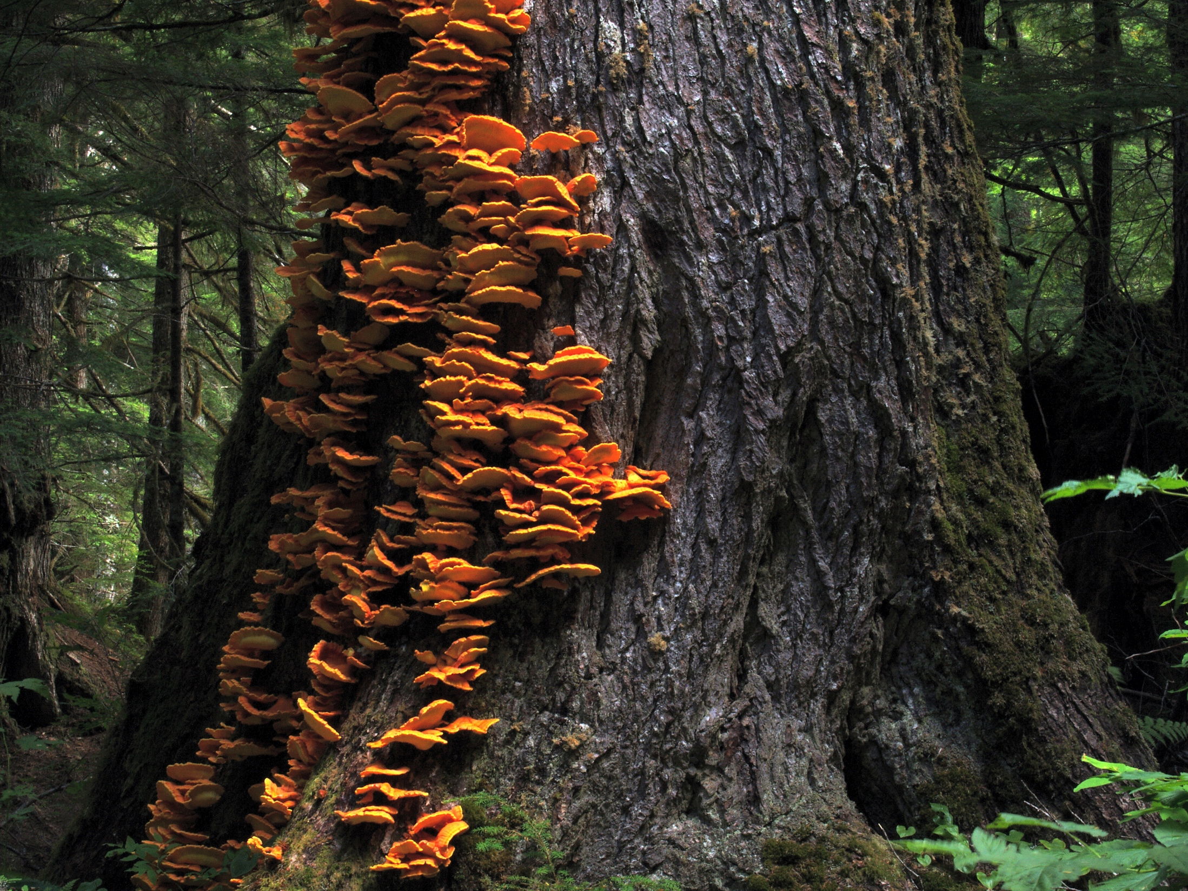
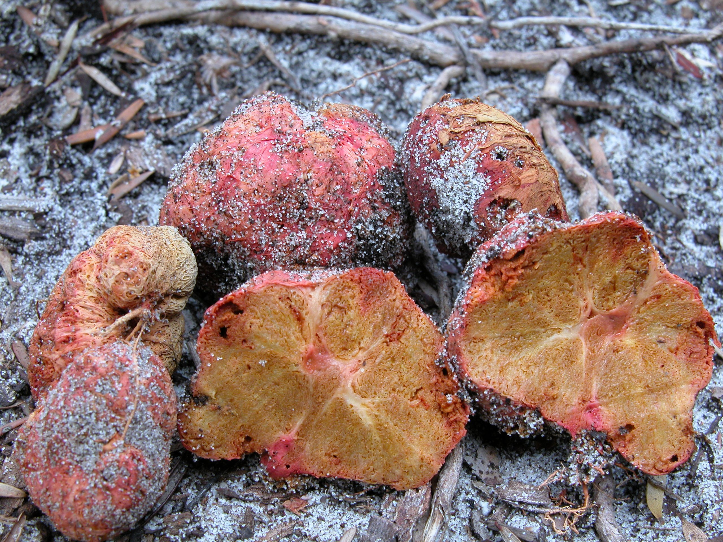
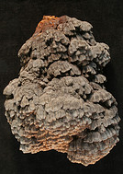
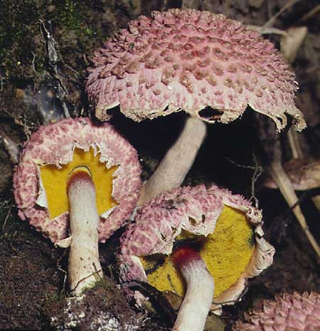
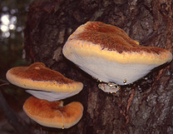
What are Macrofungi?
Notes:
Phylogenetically heterogeneous assemblage (includes both Agaricomycetes and Ascomycetes)
Produce a conspicuous spore-bearing body that is “fleshy” or “woody” in consistency
Play a key role in plant and animal life and the global carbon cycle. The group includes:
Ectomycorrhizal fungi
forest pathogens, wood-decay fungi
invertebrate predators such as nematode trapping fungi.
Food source for many animals, including humans
Incubation sites for many arthropod groups.

Slide 4
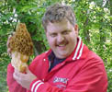
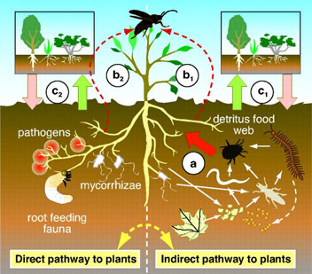
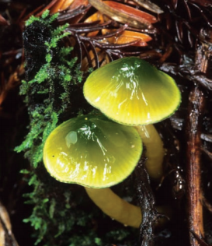
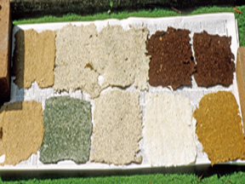
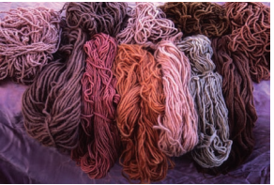
Why we care about Macrofungi
Food
Pharmaceuticals
Recreation
Forest health
Bioremediation
Crafts
Beauty

Slide 5
The Consortium of Collections Institutions: 35 institutions, including 3 botanical gardens, two natural history museums, and 31 universities from 24 states

Slide 6
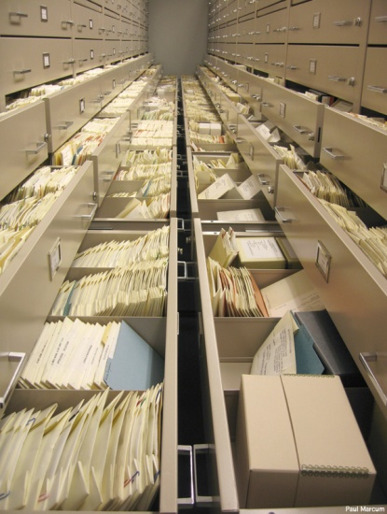
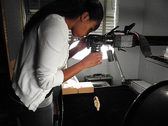
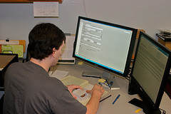
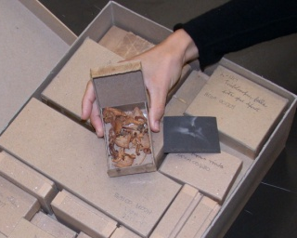
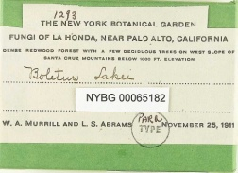
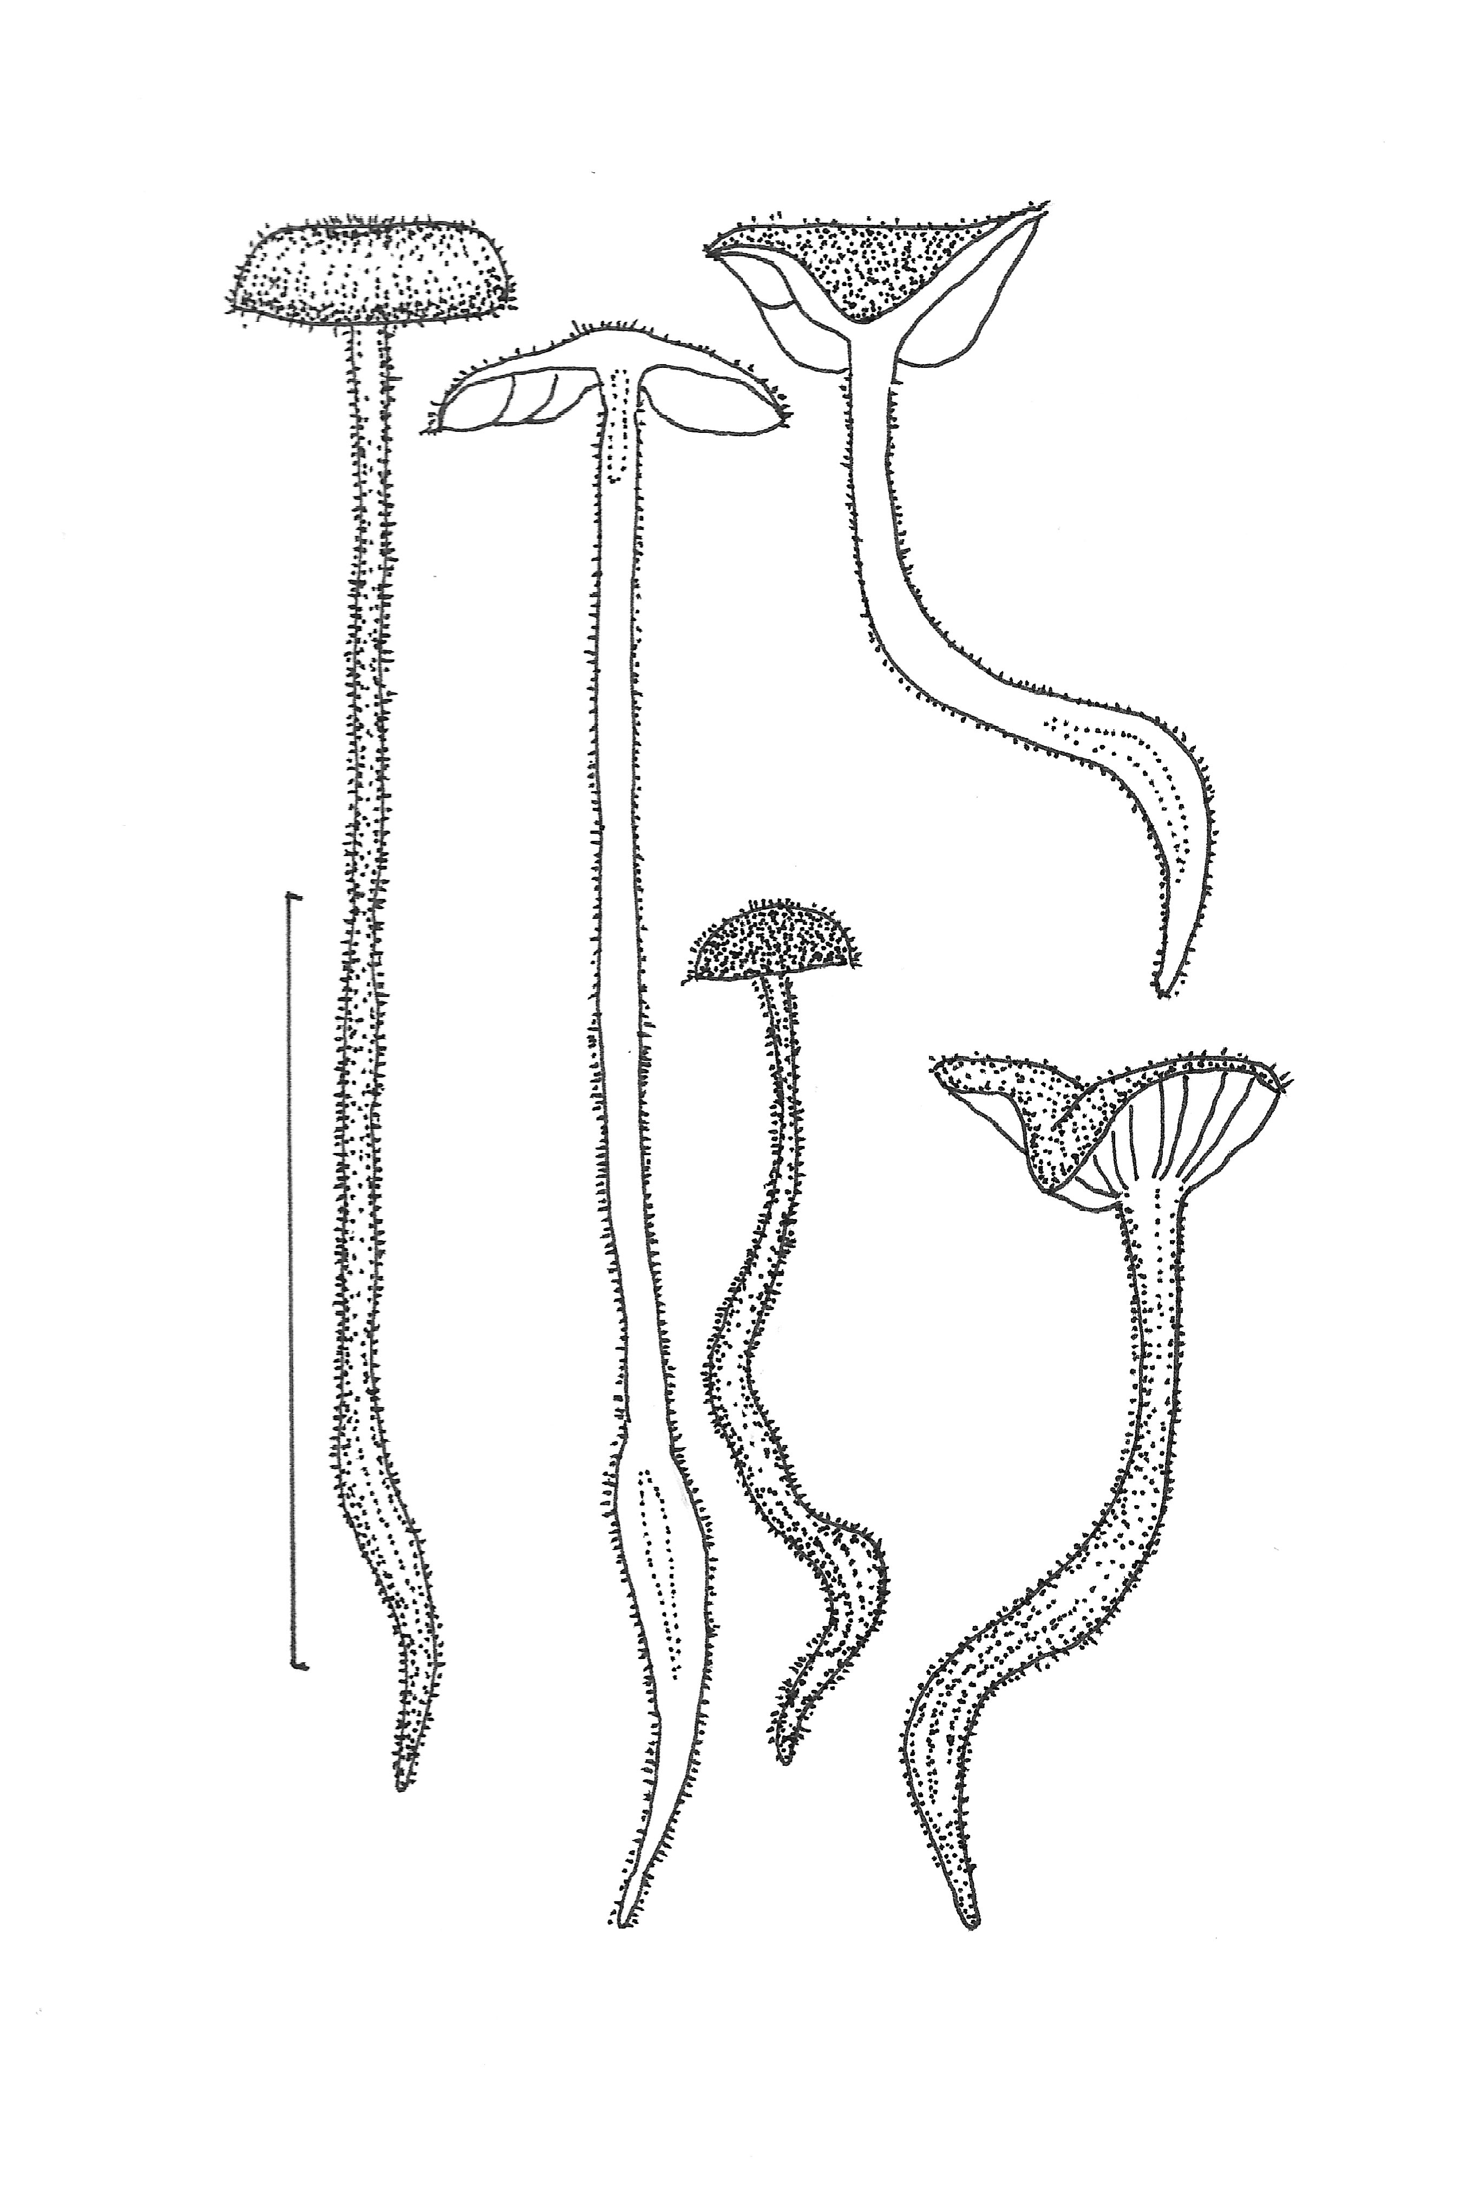
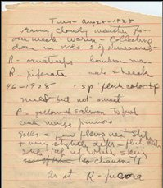
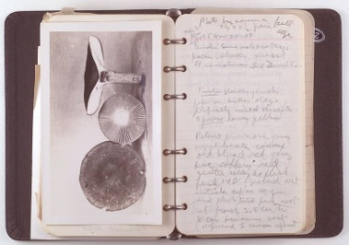
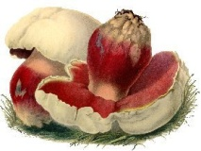
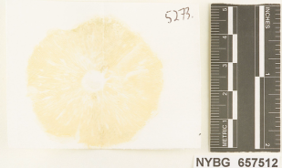
Digitize Specimen Data, Fieldnotes, Photographs
Data to be digitized:
700,000 specimen records (combined with 600,000 previously digitized specimens for a total of 1.3 million)
70,000 specimen images
144,260 photographs of living fungi (represented in specimen collections)
26,092 fieldbook pages
355,220 field notes, spore prints

Slide 7
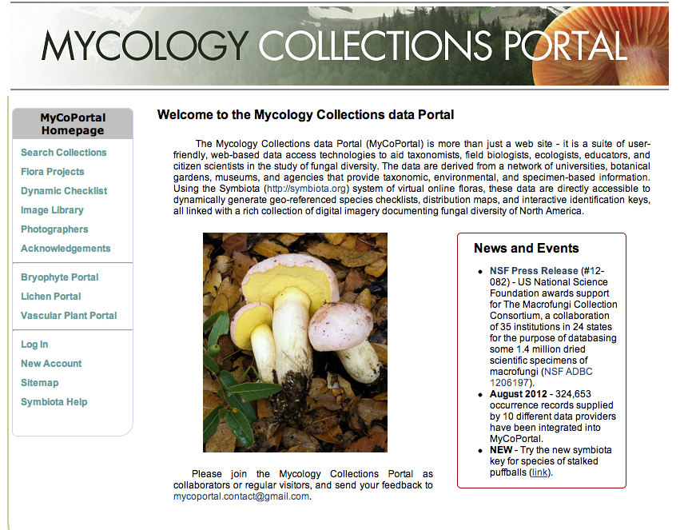
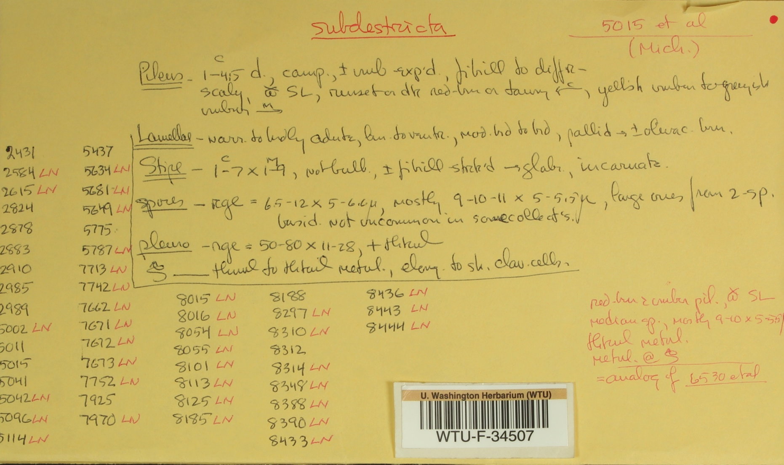
Disseminate Data through the Mycology Collections Portal
http://mycoportal.org/portal/index.php

Slide 8
Involve the Public in the MaCC
Amateur mycologists (=mycophiles) help with data editing, add content to the MycoPortal website and use data from the MycoPortal for their education and biodiversity documentation projects
Crowdsourcers help with transcription of specimen labels, and have the opportunity to learn more about fungi, natural history collections in general

Slide 9
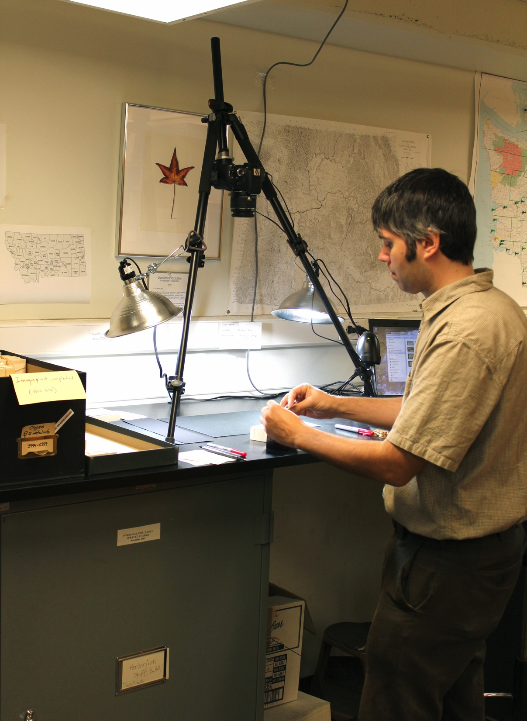
Activities : Centralizing Existing Records in the MycoPortal
Existing Records Incorporated | Existing Records Still to be Incorporated
ARIZ, DBG, F, ILLS, MICH, NY, OSC, TENN, UTC, WTU | BPI*, CUP, CORT, CUP, DUKE, LSUM*, MIN*, NCSC, WSP * Indicates incorporation currently in progress
As of Oct 2012:
416,000 occurrence records have been integrated into MyCoPortal (69% of total)

Slide 10
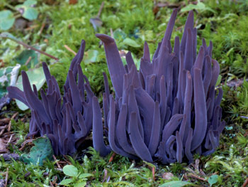
Activities to Date: Year One Participants
Status | Institutions
Fully Operational >1 month | 3
Fully Operational < 1 month | 7
Staffed, equipped, trained and ready to begin in late October | 3
Not yet started | 1
Scheduled to begin in Jan 2013 | 1
TOTAL | 15

Slide 11
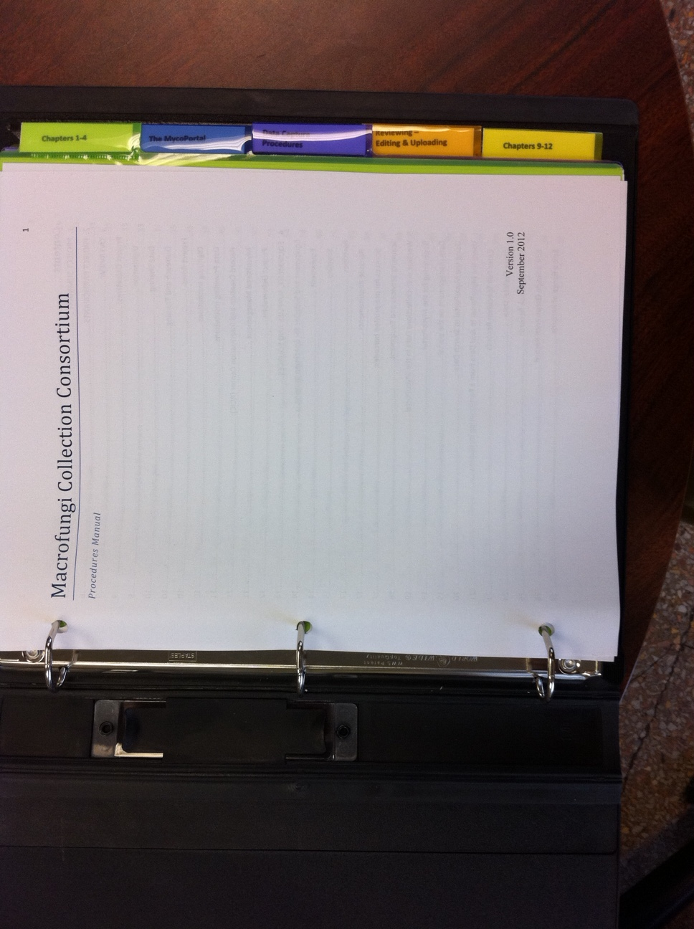
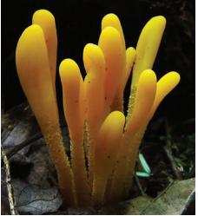
Activities: Training
Procedures Documentation
Technology kick-off meeting (July 2012)
Procedures manual (August-September 2012)
Powerpoints illustrating selected procedures ( by Jan 2012)
Short videos illustrating selected procedures (by Feb 2012)
Training Courses
Two 1.5 day training sessions at NYBG for 6 institutions (Sep-Oct 2012)
One 1.5 day training session at NYBG for 5 institutions (Nov 2012)
Individual training sessions at MICH and SFSU (Nov, Dec. 2012)

Slide 12
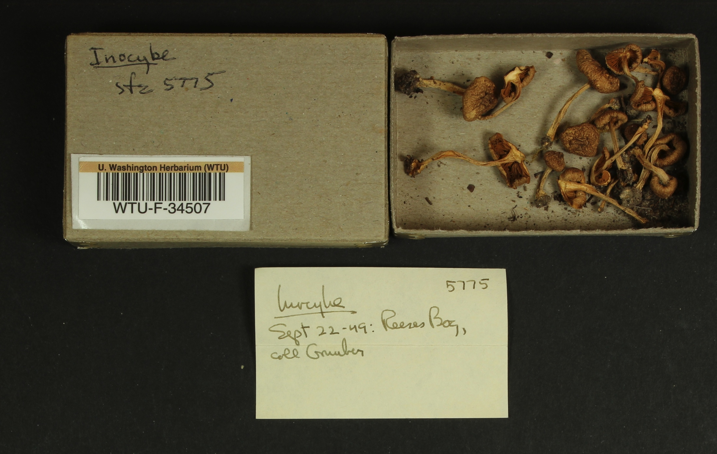
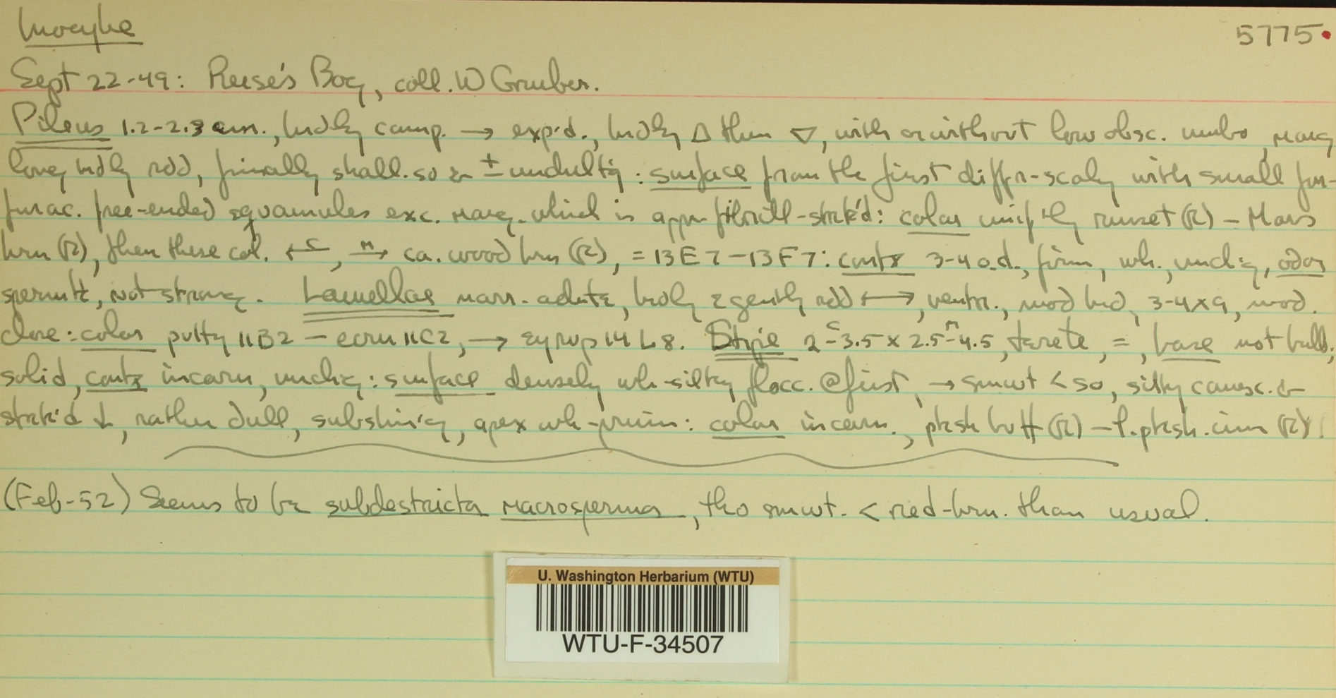
Activities to Date: Digitization
Digitization Activities | Items Completed
Fieldbook records created | 14000
Specimen labels imaged | 7300
Specimens Imaged | 500
Specimen notes imaged | 3000
Photographic slides digitized | 4500

Slide 13
MaCC Public Participation To-Do List
Activity | In Progress | Not Yet
Introduce the Amateur Mycology Community to the MaCC Project (3 events so far, one more to go in 2012) | ✔
Promote the MycoPortal as a tool for the Amateur Mycology Community (two demo/training sessions held, one more to go in 2012; on-going support) | ✔
Incorporate content generated by Amateur Mycologists into the MycoPortal. Foray lists from 10 regional clubs posted; many more in progress | ✔
Implement the crowdsourcing component of the project |  | ✔
Prepare guidelines and best practices for incorporation of crowdsourcer feedback into collections records |  | ✔

Slide 14
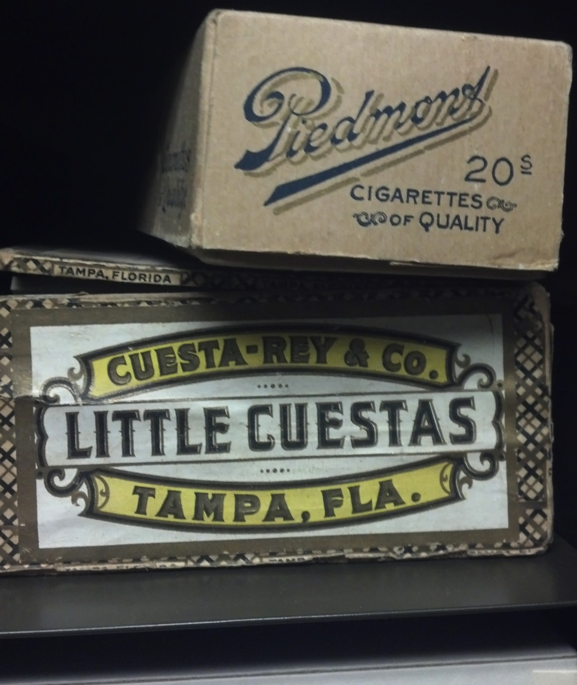
Participant Highlights
University of Florida: No specimens previously databased or imaged; curator Matt Smith discovered a print out from a database of the holdings circa 1983; print out has been scanned, processed with OCR, currently being parsed and uploaded into MycoPortal
University of North Carolina: Mycological Herbarium ignored for many years; specimens poorly organized, cabinets in a hallway; Prior to start of grant, herbarium was re-arranged and is currently moving into newly renovated space.
University of Tennessee: Specimens were previously databased, so focus is on digitization of ancillary material, namely the notes and photographs compiled by L.R. Hesler

Slide 15
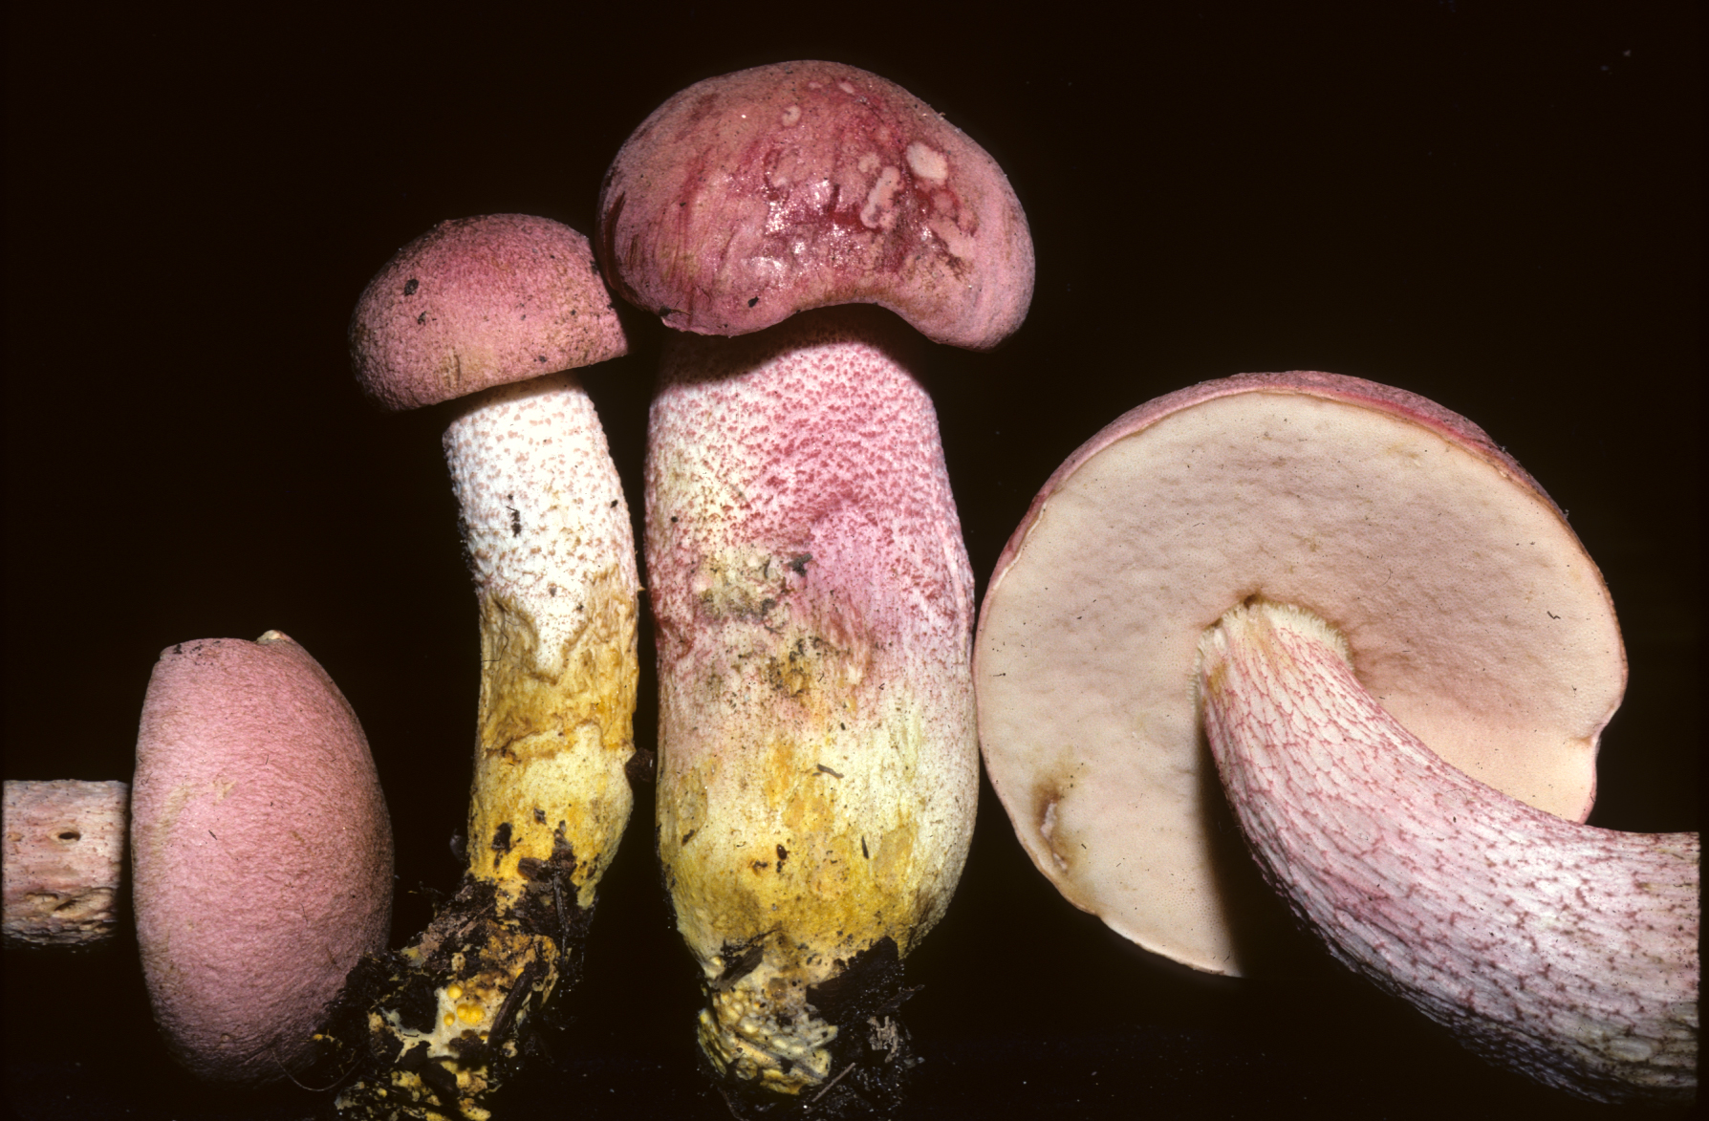
Assessment of the 1st Quarter of the MaCC Project
Likes:
Ease of use, suitability of MycoPortal for the project; dedication and skill of Portal Manager Scott Bates
Training sessions
Enthusiasm of the amateur mycology community
Not so much:
Slow start for some institutions
Monthly reporting (or lack thereof)
Counteracting the impulse to re-write
the project deliverables

